Slide 1
A Region-Splitting Imputation method for different types of missing data

Slide 2
1. Introduction

Slide 3
2. Related work

Slide 4
3. Preliminaries
In region-splitting imputation(RESI) model, imputation and partition are the most critical links. Therefore, the selection of base imputing technology and weight calculation in partitioning algorithm are both crucial.
The K-Nearest Neighbor Imputation(KNNI) method and the Entropy Weight Method are selected as the base imputer and the way to calculate weight respectively.

Slide 5
3.1. KNNI
Is a commonly used non-parametric imputation method, whose idea is as follow:
Given a test sample of missing value
Select the K nearest samples in the observed set (complete samples)
Use some distance measurement (generally Euclidean distance)
Predict according to the information of the k neighbors.
For categorical data, it uses the voting method to choose tag.
For numerical data, the average method can be adopted, that is, the average value or weighted average value of the k nearest neighbors.

Slide 6
3.1. KNNI
with other prediction models, it will cost a large amount of time to train the model in each iteration.
Different from other training methods, KNN, as a famous representative of lazy learning has almost no explicit training process.
In the training stage, it only saves the observed samples and processes them after receiving the test samples.
The training time cost of this learning technology is almost zero.
which effectively solves the computational inefficiency that may occur in the learning method

Slide 7
3.2. Entropy weight method (EWM)
Determine the weight of each attribute.
Its main idea is to decide the objective weight according to the magnitude of attribute variability.
Generally, low information entropy indicates that the attribute has a large variability and it can provide more information for the following data analysis, which means it has greater impact on the data mining results and its weight naturally increases.

Slide 8
3.2. Entropy weight method (EWM)
Step 1: Normalizing data. Given 𝑠 attributes 𝐴1 , 𝐴2 , … , 𝐴𝑖 , … , 𝐴𝑠 , where 𝐴𝑖 = {𝑎𝑖1 , 𝑎𝑖2 , … , 𝑎𝑖𝑗, … , 𝑎𝑖𝑛}, we denote the normalized value of attribute 𝐴𝑖 as 𝑌𝑖 = {𝑦𝑖1 , 𝑦𝑖2 , …, 𝑦𝑖𝑛} and each 𝑦𝑖𝑗 ∈ 𝑌𝑖 is formulized as:
𝑦𝑖𝑗 = (𝑎𝑖𝑗 − 𝑚𝑖𝑛(𝐴𝑖 )) / (𝑚𝑎𝑥(𝐴𝑖 ) − 𝑚𝑖𝑛(𝐴𝑖 ) )
Step 2: Calculating the entropy of each attribute. Suppose 𝑌𝑖 is the normalized set of the attribute 𝐴𝑖 , the possibility of each value 𝑎𝑖𝑗 ∈ 𝐴𝑖 can be computed as 𝑝𝑖𝑗 = 𝑌𝑖𝑗 ∑𝑛 𝑖=1 𝑌𝑖𝑗 . Specially, when 𝑝𝑖𝑗 = 0, lim 𝑝𝑖𝑗→0 𝑝𝑖𝑗𝑙𝑛𝑝𝑖𝑗 = 0. Thus, the entropy of the attribute 𝐴𝑖 can be calculated as:
𝐸𝑖 = −𝑙𝑛(𝑛) −1 ∑𝑛 𝑖=1 𝑝𝑖𝑗 . 𝑙𝑛 𝑝𝑖𝑗
Step 3: Determining the weight of each attribute. After computing the entropy of each attribute with Formula (2), next is to compute the weight of each attribute with :
𝑤𝑖 = 1 − 𝐸𝑖 𝑘 − ∑ 𝐸𝑖 (𝑖 = 1, 2, … , 𝑘)

Slide 9
3.3. Problem definition
Given a dataset contains lots of tuples, each of which is composed of several attributes. The attribute is in either numerical or categorical type.
Suppose there are several various types of values missed in part of tuples.
our goal is to establish a model which can effectively complete the tuples with numerical only, categorical only or mixed-type of both.

Slide 10


we formally define the problem as follows:
Definition 1 (Complete Tuple and Incomplete Tuple).
The definition of CT and ICT implies CTs have no missing items and ICTs have at least one missing item.
Definition 2 (Missing Rate).
represents the percentage of its missing items in its total items.
where 𝑁𝑚𝑖𝑠𝑠 is the number of missing items in dataset.
Definition 3 (Complete Ratio).
refers to the proportion of complete tuples in dataset.
in which, 𝐶𝑇D and 𝐼𝐶𝑇D are the set of complete and incomplete tuple of D, respectively.

Slide 11
we formally define the problem as follows:
Definition 4 (Missing Type).
can be divided into two subsets, that is, 𝑀D = 𝑀𝑛𝑢𝑚 ⋃ 𝑀𝑐𝑎𝑡 where 𝑀𝑛𝑢𝑚 and 𝑀𝑐𝑎𝑡 stand for numerical and categorical missing values respectively, and obviously 𝑀𝑛𝑢𝑚 ∩ 𝑀𝑐𝑎𝑡 = 𝜙.
missing type of D can be classified as:
Categorical-missing dataset
Numerical-missing
Mixed-type missing dataset
In reality, it is more common for the above three types of missing values to exist simultaneously.

Slide 12
THE GOAL OF THIS ARTICLE IS TO DESIGN AND IMPLEMENT A SOLUTION THAT CAN EFFECTIVELY IMPUTE THESE THREE DIFFERENT TYPES OF MISSING VALUES AT THE SAME TIME.

Slide 13
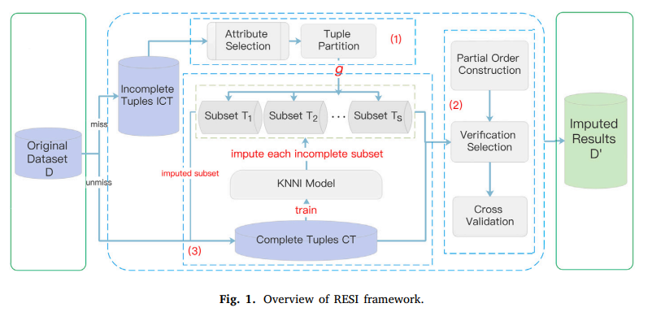
4. Our model

Slide 14
4.1. Framework of RESI
Divide the input dataset into two parts: complete tuples & incomplete tuples.
CT is used as the training set for KNNI
ICT are partitioned into several subsets, named incomplete subsets according to their missing degree. Each incomplete subset is respectively taken as a test set and filled with the previously trained KNNI model.

Slide 15
4.1. Framework of RESI
RESI accomplishes the imputation in three steps:
tuple partition
incomplete subsets imputation
cross correction.
The final filling results are obtained by averaging the predicted values of (2) and (3).

Slide 16
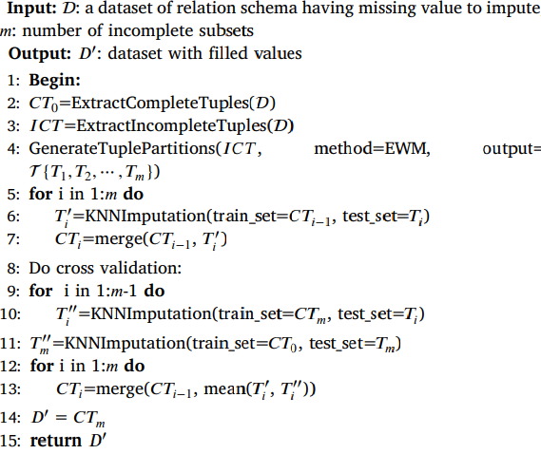
Algorithm 1: Algorithm of Subset Imputation

Slide 17
4.2. Tuple partition
It is not reasonable to deal with all incomplete tuples at the same time during the imputing process.
Practice shows that different attributes have different effects on subsequent analysis
In a dataset instance, different missing items of tuples will also have different impact on subsequent modeling.
So we define an indicator called tuple integrity rate.

Slide 18
Integrity rate
Definition 5 (Tuple Integrity Rate).
Example of computing tuple integrity rate
In current example, the importance of birthplace varies from that of workplace in the modeling of wages. Assuming that with EWM, we compute the weight of birthplace is 0.10 and that of workplace is 0.11, and the birthplace is a missing item in tuple 𝑡𝑎 , while the workplace is a missing item in tuple 𝑡𝑏 . Both 𝑡𝑎 and 𝑡𝑏 have no other missing items. Then, the tuple integrity rate of 𝑡𝑎 and 𝑡𝑏 are 0.90 and 0.89, respectively.

Slide 19
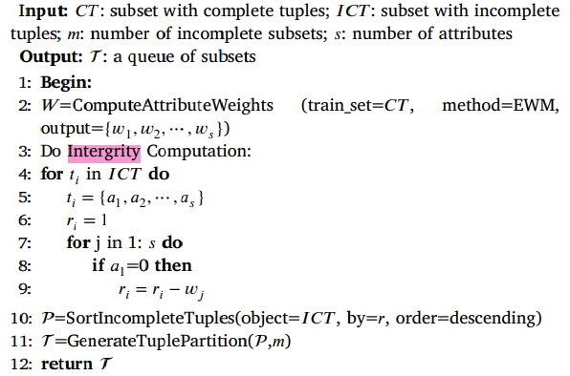
Algorithm 2: Algorithm of Generating Tuple Partitions.

Slide 20
4.3. Incomplete subsets imputation

Slide 21
4.4. Cross correction

Slide 22
4.5. Complexity of algorithm
Weight calculation → O(s × t)
All date is traversed and normalized.
Tuple Partition → O(s × t)
Each tuple in the dataset is traversed to determine if it is an incomplete tuple.
Calculating the integrity rate
Missing value imputation → O(n × t)
It is necessary to traverse and fill all missing items in turn, and cross-verify the correction strategy for each tuple.
Hence, the overall time complexity is 𝑇 = 𝑂(𝑠×𝑡)+𝑂(𝑠×𝑡)+𝑂(𝑛×𝑡), and when 𝑛 ≫ 𝑠, the complexity approximates 𝑂(𝑛 × 𝑡).

Slide 23
5. Experiments and analysis

Slide 24
6. Conclusion

Slide 25
Thanks

